Slide 1

Interactive Mobile Robot - Bobert
Elizabeth Herrejon, Nishant Sharma, Changxuan Yao
ECE 4180 Final Project
Georgia Institute of Technology

Slide 2

Introduction
The robot takes in commands from the Bluefruit LE Connect APP via Bluetooth.
Autonomous mode (“1” on Bluetooth)
Takes in distance information from the UltraSonic sensor.
Obstacle within 400 mm – stops, turns, and continues to drive forward.
Changes expressions via button presses.
Teleoperated mode (“2” on Bluetooth)
Drive forward, backward, and turn via D-Pad button presses.
Stop if obstacle is sensed.
Change expressions via button presses.

Slide 3
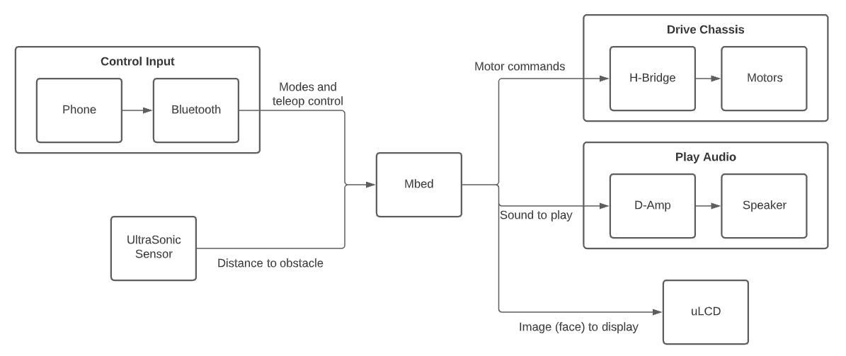
Block Diagram

Slide 4
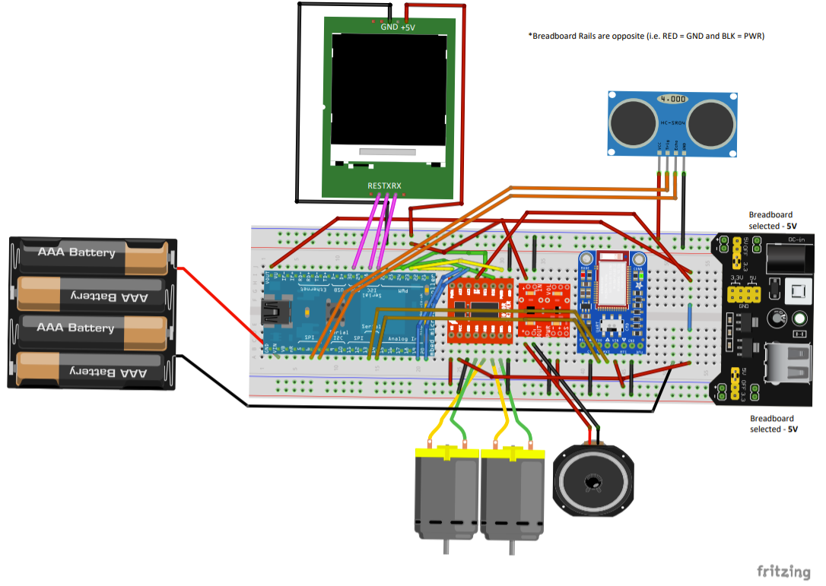
Schematic

Slide 5
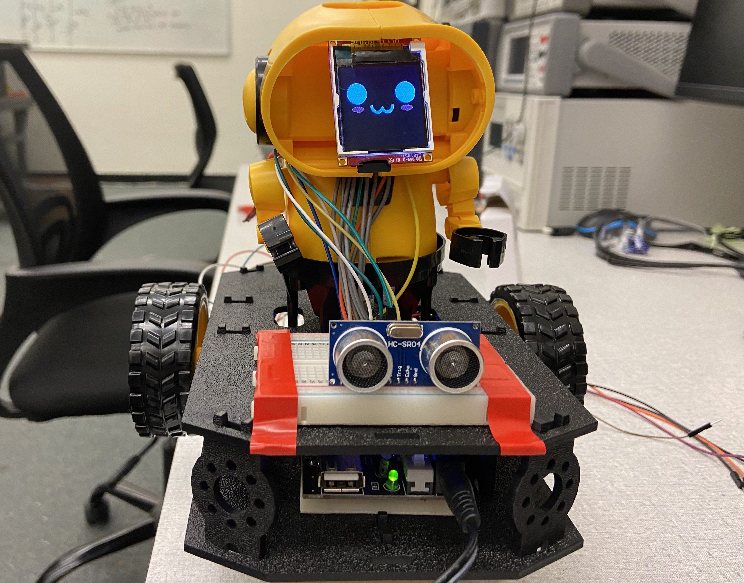
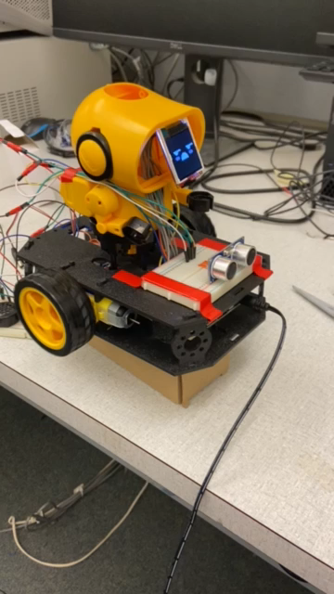
Picture of Bobert

Slide 6
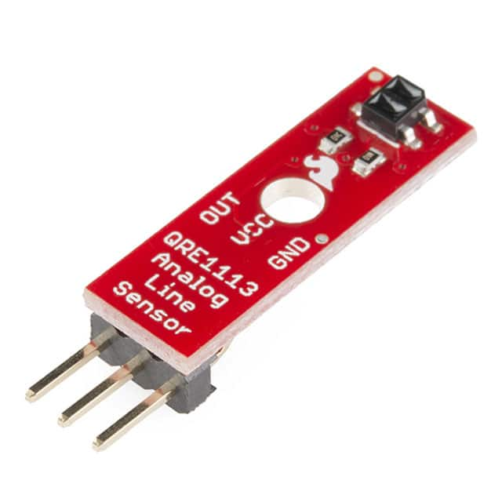
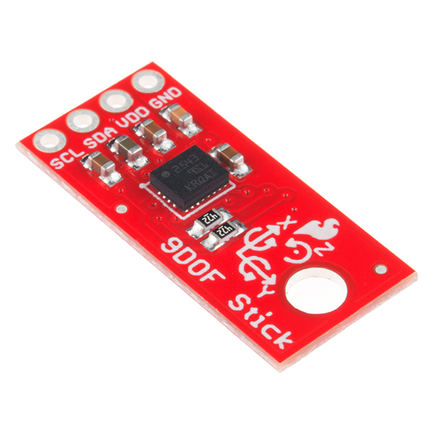
Possible Improvements

